Slide 1

NURSE HACK 4 HEALTH – VIRTUAL HACKATHON
Team 20 – ICU Helper

Slide 2
Demonstration video removed due to file size limitations of GitHub
Notes:
Scene 1
So we are Team 20 and our Project for the nurse hackathon is called ICU Helper.
The Challenge Area we are focused on tis

Slide 3
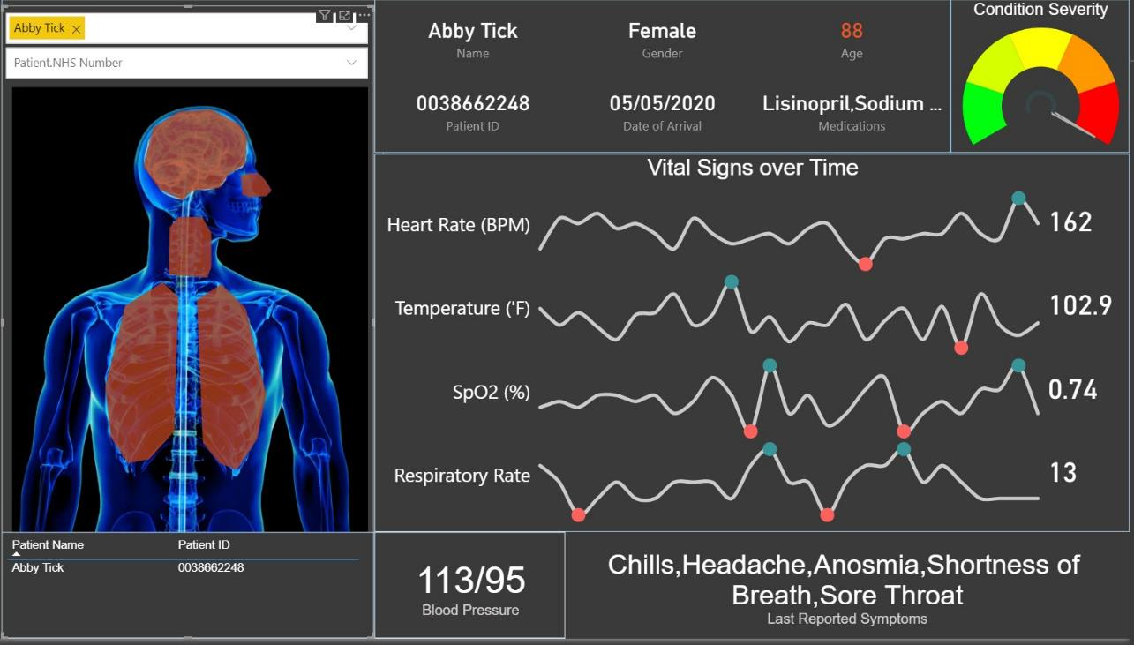

Slide 4
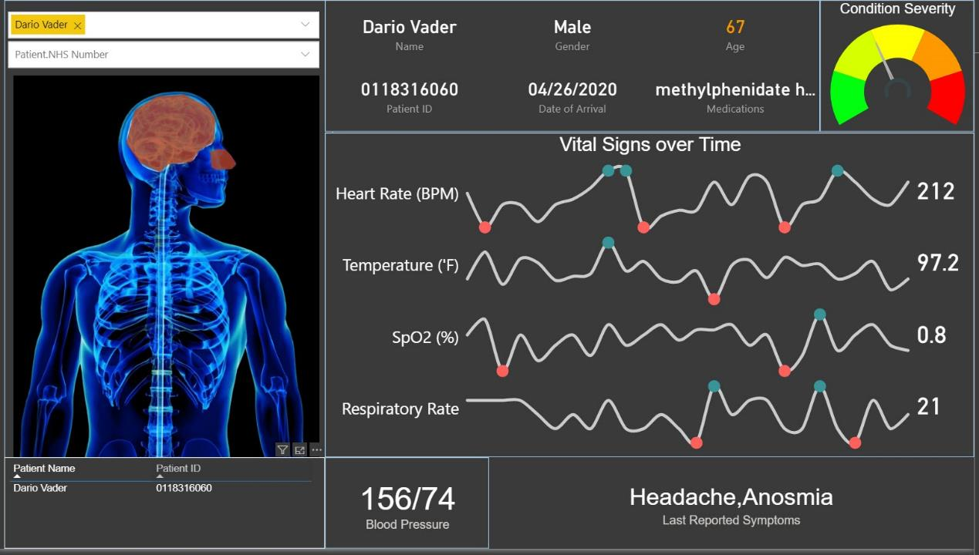

Slide 5
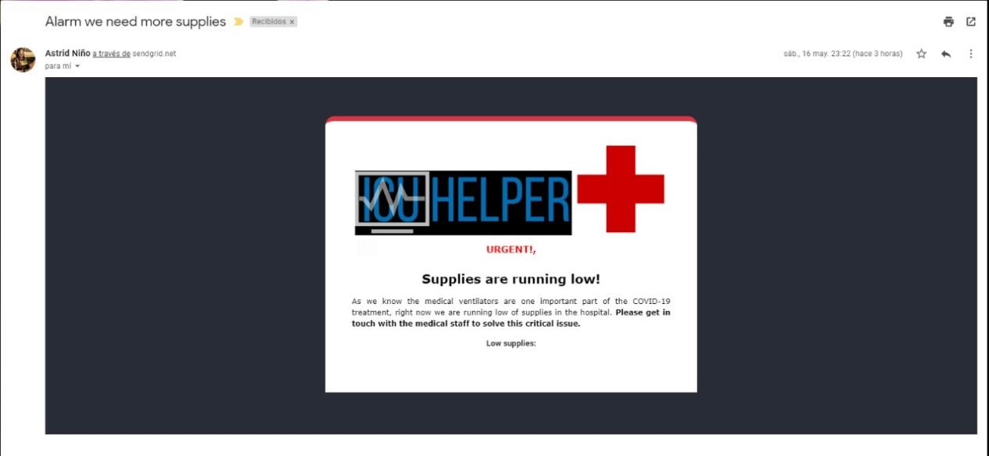

Slide 6
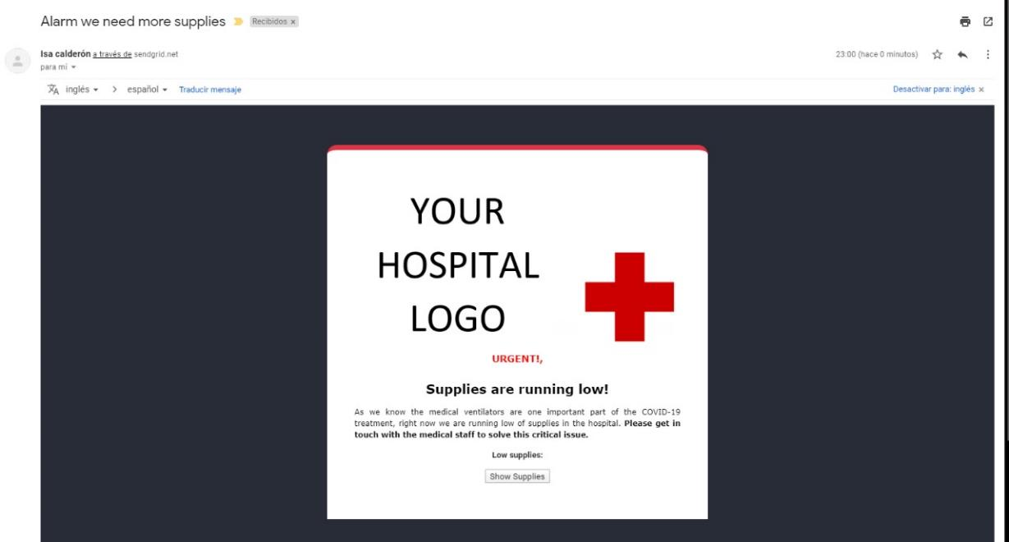

Slide 7
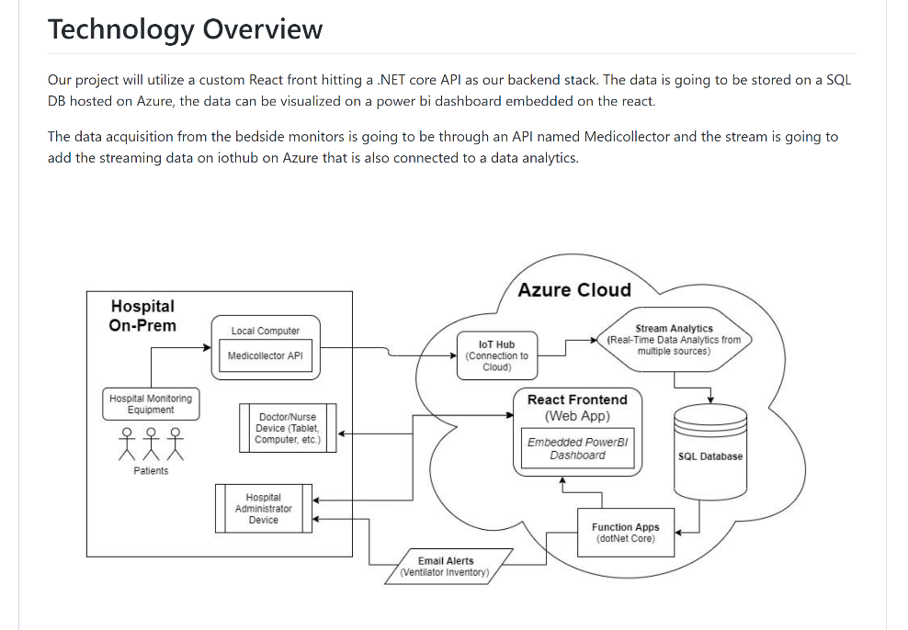

Slide 8
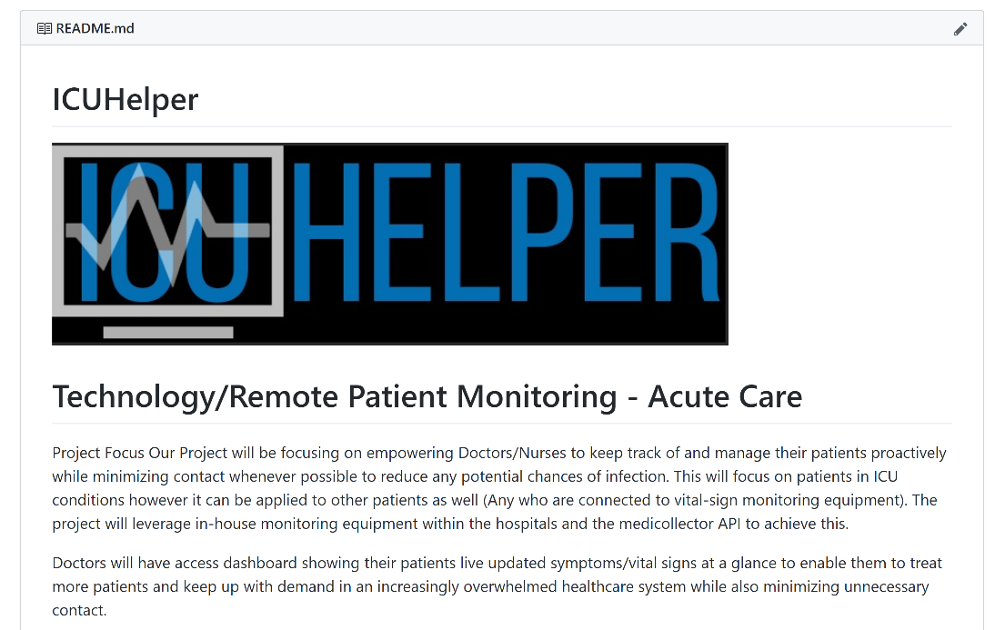

Slide 9
GitHub Project
https://github.com/NurseHack4Health/ICUHelper

